Slide 1
Class construction: Dependencies, aggregation, composition & basic interfaces
Dr. Jeff Hill

Slide 2
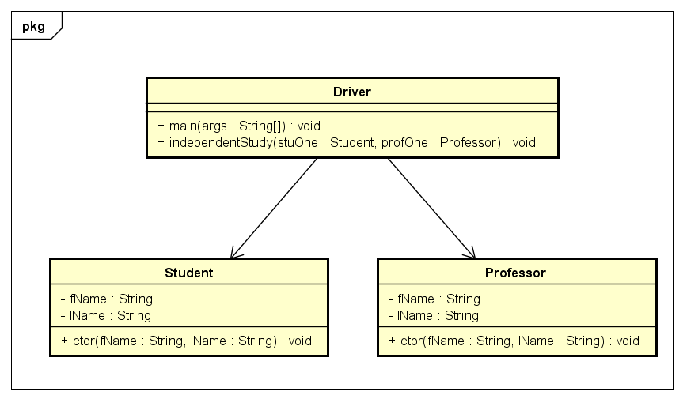
Dependencies
Remember: functional decomposition relates to breaking processes down into atomic elements
Proper class design relates to putting all of those elements in the “right place”
The “right place” usually are in separate class definitions
This creates dependencies between these various classes
Managing these dependencies becomes critical as a program’s complexity increases
Why?

Slide 3
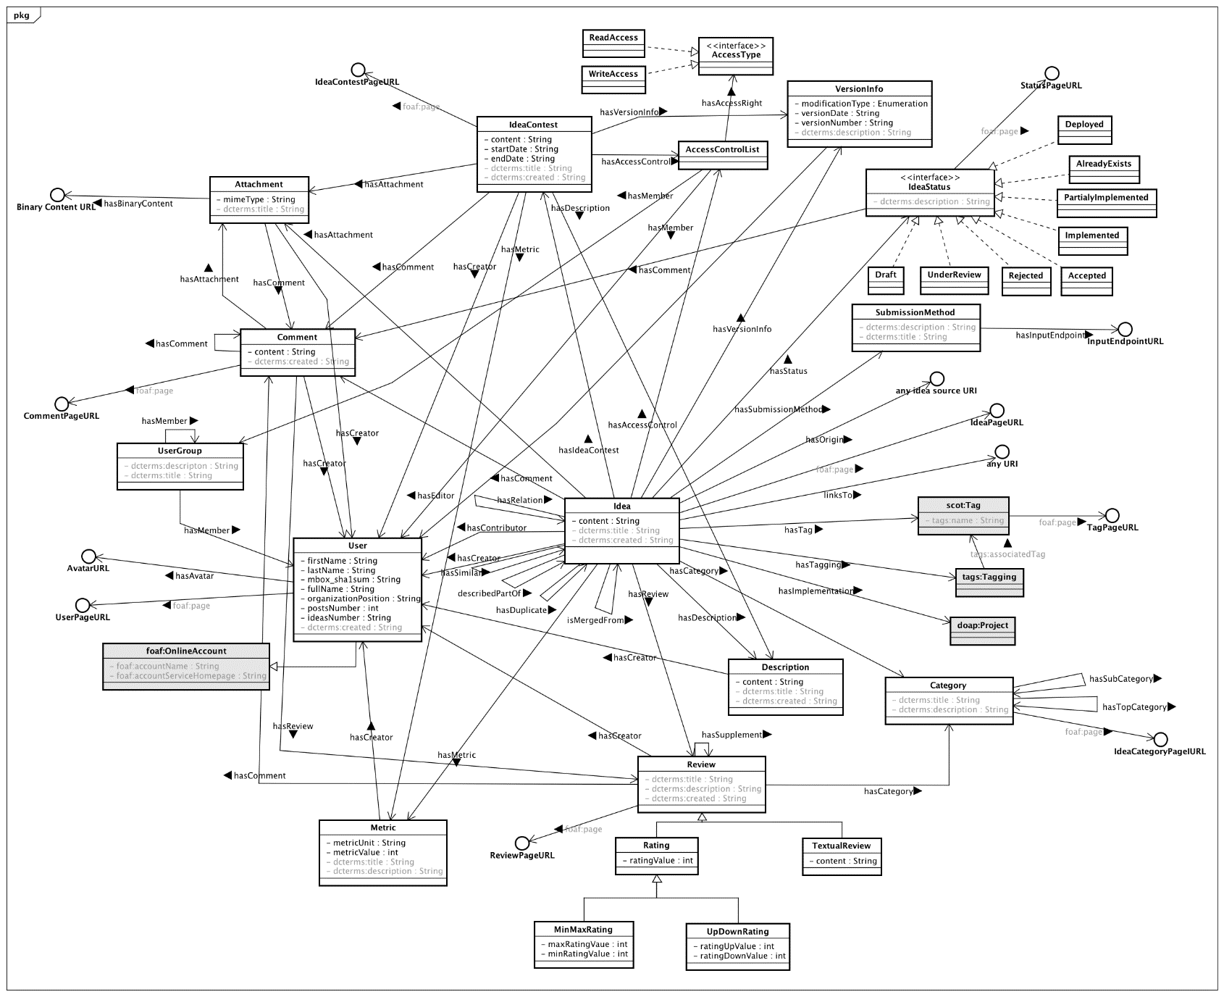
Because real programs are complex
If we don’t manage the complexity, it overwhelms us
Reference: http://www.gi2mo.org/0.4/img/class_diagram_v0.4.png

Slide 4
Complexity management
OOP has evolved a series of construction techniques for assembling atomic elements into class definitions and class definitions into functional programs
This is the focus of the next 4 classes
Today:
Association
Aggregation
Composition
Interfaces

Slide 5
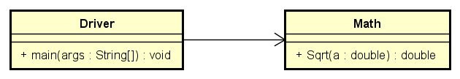
Association
The simplest of the construction techniques
Text uses this technique without naming it as an example of dependencies
Doesn’t include object instantiation
2 (or more) classes use services provided by each other
Usually unidirectional
Generally used for utilitarian purposes
Uses the open arrowhead to designate this technique on a class diagram
System.out.println(Math.sqrt(25.0));

Slide 6
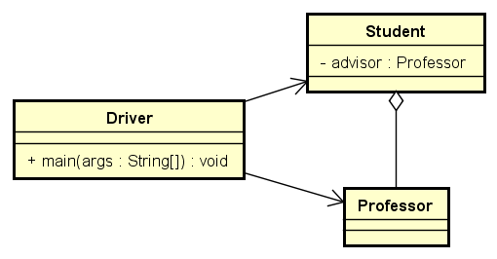
Aggregation
Revolves around the concept of ownership
Require 2 (or more) object instantiations
One class “owns” a reference to another object
A reference for an object of the “owned” class will exist within the class definition of the “owning” class
This diagram is simplified to focus purely on the aggregation technique
Uses the empty diamond head to designate this technique on a class diagram
The symbol may seem “backwards” as it is drawn from Student to Professor

Slide 7
Aggregation
package class12;
public class Student implements Comparable<Student> {
private final String fName;
private final String lName;
private final Professor advisor;
public Student(String fName, String lName, Professor advisor) {
this.fName = fName;
this.lName = lName;
this.advisor = advisor;
} // end ctor
public String getfName() {
return this.fName;
} // end getfName
public String getlName() {
return this.lName;
} // end getlName
public String toString() {
return this.getfName() + " " + this.getlName() +
", advised by " + this.advisor;
} // end toString
@Override
public int compareTo(Student o) {
return this.getlName().compareTo(o.getlName());
} // end compareTo
} // end Student
Student class will change a bit
Professor class is unaltered
Professor and Student are instantiated in main
Professor instance is passed via ctor
Student “owns” advisor reference
Professor advisorOne = new Professor("Jim", "Downey");
Student stuOne = new Student("Grace", "Hopper", advisorOne);
Student stuTwo = new Student("Steve", "Jobs", advisorOne);
System.out.println(stuOne);
System.out.println(stuTwo);

Slide 8
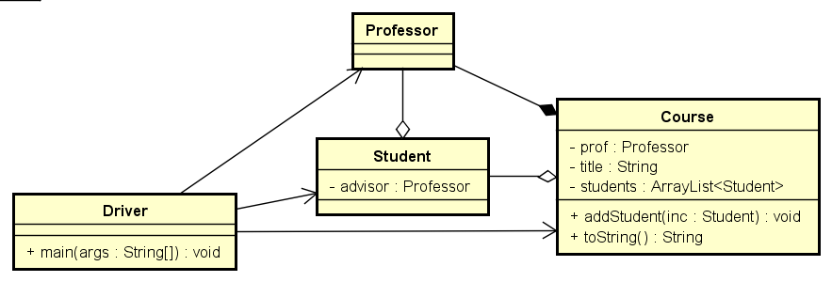
Composition
Revolves around ownership and lifecycle dependency
Require 2 (or more) object instantiations
Can be only 1 as the Driver & main method may be composed of instances as well
One class “owns” a reference to another object
A reference for an object of the “owned” class will exist within the class definition of the “owning” class
The “owned” class will be instantiated inside the “owning” class
Uses the filled diamond head to designate this technique on a class diagram
The symbol may seem “backwards” as it is drawn from Course to Student

Slide 9
Composition
package class12;
import java.util.ArrayList;
import java.util.Collections;
import java.util.List;
public class Course {
private final Professor prof;
private final String title;
private List<Student> students = new ArrayList<Student>();
public Course(String title, String fName, String lName) {
this.title = title;
this.prof = new Professor(fName, lName);
} // end ctor
public void addStudent(Student inc) {
students.add(inc);
} // end addStudent
public String toString() {
Collections.sort(students);
String roster = "";
for (Student eachOne: students) {
roster += eachOne + ", ";
} // end for
// gets rid of extra comma and space at end
roster = roster.substring(0, roster.length() - 2);
return "The course " + this.title + " is taught by " + this.prof
+ " and includes these students: " + roster;
} // end toString
} // end Course
Student and Professor classes are unaltered
Course and Students are instantiated in main
Professor is instantiated inside Course
Course “owns” professor reference
System.out.println("COMPOSITION EXAMPLE");
Course courseOne = new Course("MIS 3339", "Jeff", "Hill");
courseOne.addStudent(stuOne);
courseOne.addStudent(stuTwo);
System.out.println(courseOne);

Slide 10
Interfaces
We’ve used an interface already
Comparable<Class>
Just like Java has built-in classes, yet we can make our own
Java has built-in interfaces, and we can make our own
Interfaces can be used in several ways
The simplest is to think of them as a “class lite”
Defines a usable type, just like a class
Defines members, just like a class
No instance members, any variable is implicitly static and final
Java <= 7, all methods are abstract
No implementation, just the signature line
Java 8 changed this… we can have default methods in interfaces
We won’t use this technique

Slide 11
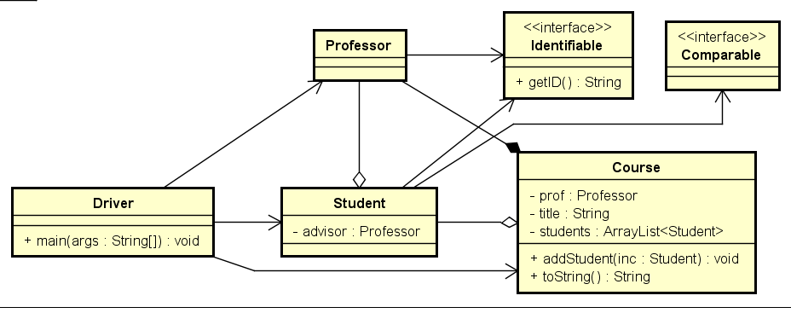
Interfaces
Lets us add capabilities to multiple classes while still defining it one single time
Fosters the code reusability concept
Can result in code duplication as the method concrete implementations must be coded in each class that implements the interface
This is why they added default methods to Java 8
This example shows:
Comparable interface that we’ve implemented in Student previously
Identifiable interface that provides a getID() method that all implementing classes must have

Slide 12
Interface
package class12;
public interface Identifiable {
public abstract String getID();
} // end Identifiable
Create using the interface keyword
Define the method signature for as many methods as are necessary for the concept
Using the abstract keyword is optional, but good practice
All abstract methods in the interface must be implemented in each class that will be “tagged” with the interface

Slide 13
Interface
package class12;
public class Professor implements Identifiable {
private final String fName;
private final String lName;
private final String id;
public Professor(String fName, String lName, String id) {
this.fName = fName;
this.lName = lName;
this.id = id;
} // end ctor
@Override
public String getID() {
return this.id;
} // end getID
public String toString() {
return this.fName + " " + this.lName;
} // end toString
} // end Professor
“Tag” the class
Implement required methods
Implement any other instance members to support the new methods
Adjust existing methods such as the ctor as necessary

Slide 14
Interface
package class12;
public class Student implements Comparable<Student>, Identifiable {
private final String fName;
private final String lName;
private final String id;
private final Professor advisor;
public Student(String fName, String lName, String id, Professor advisor) {
this.fName = fName;
this.lName = lName;
this.id = id;
this.advisor = advisor;
} // end ctor
public String getfName() {
return this.fName;
} // end getfName
@Override
public String getID() {
return this.id;
} // end getID
public String getlName() {
return this.lName;
} // end getlName
public String toString() {
return this.getfName() + " " + this.getlName() +
", advised by " + this.advisor;
} // end toString
@Override
public int compareTo(Student o) {
return this.getlName().compareTo(o.getlName());
} // end compareTo
} // end Student
“Tag” the class
Comma separate multiple interfaces
Implement required methods
Implement any other instance members to support the new methods
Adjust existing methods such as the ctor as necessary

Slide 15
Interface
Driver class
// Aggregation example
System.out.println("AGGREGATION EXAMPLE");
Professor advisorOne = new Professor("Jim", "Downey", "ABC123");
Student stuOne = new Student("Grace", "Hopper", "B0123456", advisorOne);
Student stuTwo = new Student("Steve", "Jobs", "B0456789", advisorOne);
System.out.println(stuOne);
System.out.println(stuTwo);
// Interface example
System.out.println("INTERFACE EXAMPLE");
System.out.println(advisorOne.getID());
System.out.println(stuOne.getID());
System.out.println(stuTwo.getID());
Update main method to add in the unique identifier for Student and Professor instances

Slide 16
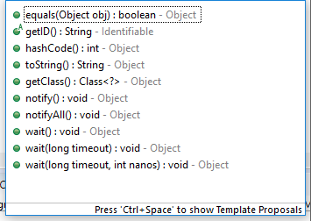
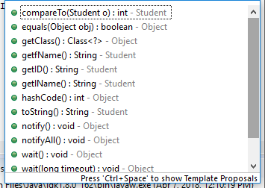
Interface
Identifiable demo = stuOne;
System.out.println(demo.getID());
Identifiable
Interfaces can be used as types
Can declare object references using these types
Note: it is impossible to instantiate an object of an interface’s type
e.g. new Identifiable() ← this is not possible
Members will be limited to only interface methods
We will learn why this is important when we get to polymorphism in a few more classes
For now, just know and remember we can use interfaces as a type, just like classes
Student

Slide 17
Questions?

